Slide 1

DeepShield: AI-Powered Digital Forensics for Multi-Modal Deepfake Detection and Mitigation
SRM INSTITUTE OF SCIENCE AND TECHNOLOGY
DEPARTMENT OF COMPUTER SCIENCE AND ENGINEERING
21CSP401L MAJOR PROJECT / 21CSP402L - MAJOR PROJECT with 21CSP403L INTERNSHIP
Batch ID: BT26COREC003
Group Members-
(CSE - C core)
Sparsh Garg - RA2211003030192
Arpit Singhal- RA2211003030197
Nishant Kumar - RA2211003030151
Devansh Shishodia-RA2211003030181
Guide name: Dr. Jitendra Singh
Designation: Associate Professor Department: Computer Science and Engineering

Slide 2
Abstract
Accurate and reliable identification of deepfake content across images, videos, and audio is critical for maintaining digital trust and preventing misuse of synthetic media. However, existing deepfake detection systems and general-purpose AI models often struggle to handle diverse manipulation techniques and may fail under real-world conditions, leading to unreliable or misleading results. These systems frequently rely on single modalities or closed-set assumptions, which limits their effectiveness against evolving deepfake generation methods. To address these challenges, this paper presents DeepShield, an AI-powered digital forensics framework for multi-modal deepfake detection. The proposed system combines separate visual and audio analysis modules with a unified detection pipeline to assess the authenticity of multimedia content. DeepShield is designed to analyze spatial, temporal, and spectral inconsistencies introduced during media manipulation and to provide a consolidated prediction across modalities. To improve transparency, the framework incorporates basic forensic explanations such as attention maps and confidence indicators. The system emphasizes simplicity, reproducibility, and practical deployment using publicly available datasets and lightweight models. Overall, DeepShield aims to support safer and more reliable identification of synthetic media by providing an interpretable and accessible AI-assisted solution for academic and forensic applications.

Slide 3
Introduction & Problem Statement
The rapid growth of generative artificial intelligence has enabled the creation of highly realistic synthetic images, videos, and audio, commonly referred to as deepfakes. While these technologies offer creative and commercial benefits, they also pose serious risks to digital trust, identity security, and information integrity. Deepfakes can be misused for impersonation, misinformation, fraud, and social manipulation, making reliable detection an important challenge for digital forensics and cybersecurity. Existing deepfake detection approaches often rely on single modalities such as visual or audio data and are typically trained under closed-set assumptions. As a result, their performance degrades when exposed to unseen manipulation techniques, real-world compression, or partial media tampering. Moreover, many deep learning–based detectors operate as black-box systems, providing limited interpretability and reducing their usefulness in forensic investigations. These limitations highlight the need for a practical and interpretable multi-modal deepfake detection framework. This research addresses this problem by proposing DeepShield, a unified system that analyzes both visual and audio cues to improve robustness, transparency, and reliability in detecting synthetic media under realistic conditions.

Slide 4
Existing System
Existing deepfake detection systems rely heavily on single-modality feature similarity, assuming that one type of evidence (visual or audio) is sufficient.
These systems assume the extracted features are always reliable, without verifying consistency across multiple modalities.
When manipulation artifacts are subtle or unseen, models produce unreliable predictions due to incomplete or weak feature cues.
If the detector fails to capture relevant manipulation patterns, the system still outputs a decision, leading to false confidence or misclassification.
There is no fallback or compensatory mechanism when one modality fails or is missing.
As a result, existing systems lack robustness and perform poorly under real-world conditions and novel deepfake generation techniques.

Slide 5
Problem statement and Objectives
Problem: The increasing use of generative AI has led to the widespread creation of realistic deepfake images, videos, and audio, posing serious risks to digital trust, identity security, and misinformation control. Existing deepfake detection systems are often unimodal, lack robustness to unseen manipulations, and provide limited interpretability.
Objective: The objective of this work is to develop DeepShield, a practical multi-modal deepfake detection framework that analyzes both visual and audio cues, improves robustness under real-world conditions, and provides basic forensic explanations using publicly available datasets.

Slide 6
Proposed System
The proposed system, DeepShield, improves traditional deepfake detection approaches by introducing a multi-modal and robust analysis framework for images, videos, and audio.
Instead of relying on a single modality, the system combines visual and audio detection modules to improve reliability under real-world conditions.
The system first analyzes available media using modality-specific deep learning models to extract manipulation-related features.
If one modality provides weak or unreliable evidence, the system leverages the complementary modality to compensate and generate a more reliable decision.
DeepShield integrates a simple fusion mechanism to combine predictions from multiple modalities into a unified output.
To enhance transparency, the system generates basic forensic explanations such as attention heatmaps and confidence scores.
This approach ensures more consistent and interpretable detection compared to unimodal systems.
The architecture is modular and extensible, allowing easy integration of additional models or modalities in future work.

Slide 7
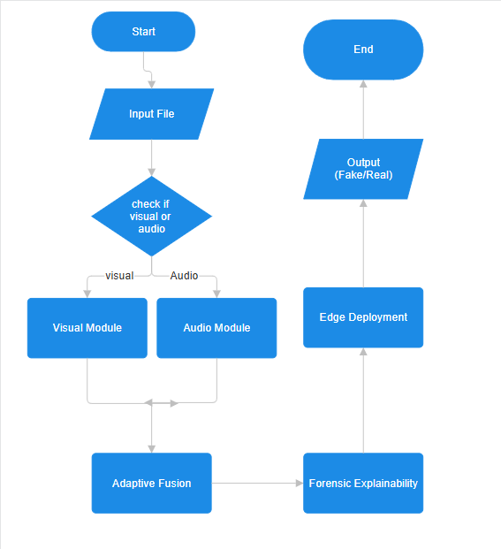
Architecture/Block Diagram of the proposed model

Slide 8
Modules Description
1. Extension-Aware Router
• Auto file detection (.mp4, .wav, .mkv)
• Smart modality routing
2. Visual Forensics
• Face detection + preprocessing
• Depthwise separable convolutions
• Grad-CAM forensic heatmaps
3. Audio Forensics
• Log-Mel spectrogram analysis
• Graph attention networks
• Phoneme synchronization maps

Slide 9
Modules Description
4. Adaptive Fusion
• Dynamic α-weighting
• Modality confidence balancing
• Lip-sync verification
5. Forensic Explainability
• Visual artifacts heatmaps
• Audio-visual sync breakdown
• Chain-of-custody logs
6. Edge Deployment
• ONNX quantization
• 1.5GFLOPs optimization
• Mobile-ready inference

Slide 10
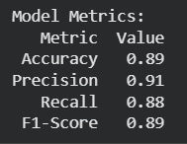
Intermediate Results and Discussion
Intermediate Model Metrics for Audio Detection Module

Slide 11
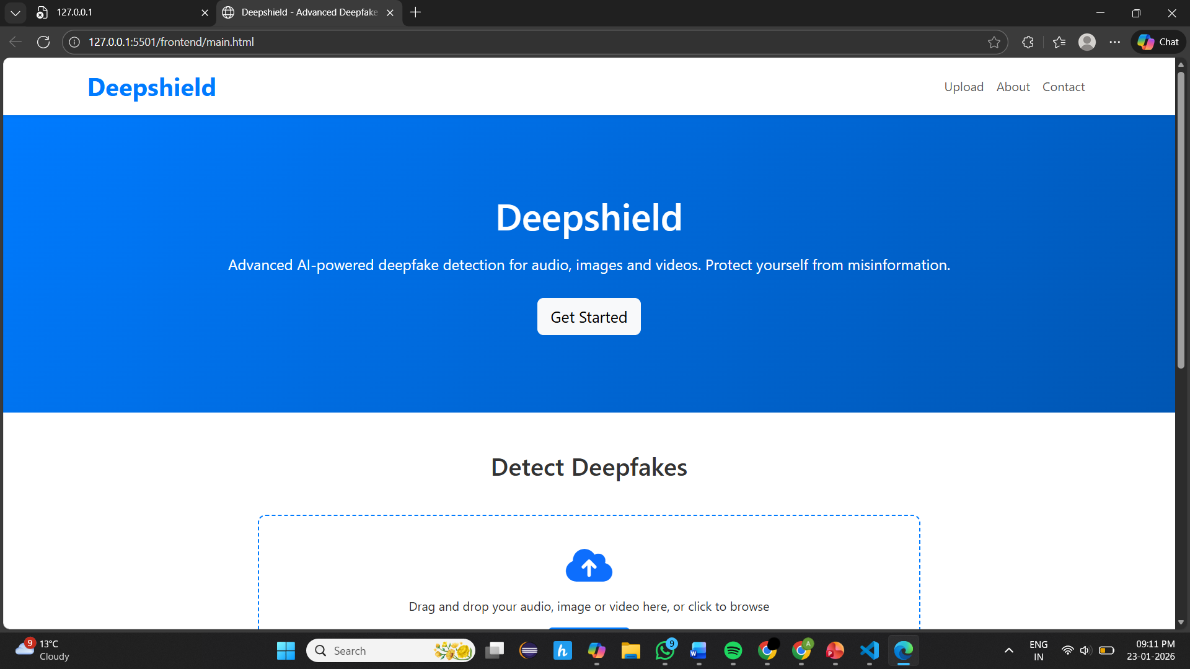
Intermediate Results and Discussion
Frontend of the Project

Slide 12
Intermediate Results and Discussion
We have increased our dataset from 0.06M flac files to 0.15M files
A curated deepfake dataset (FaceForensics++, DFDC, Celeb-DF, and self-generated augmented samples) has been used to provide structured and diverse manipulation patterns.
When the primary deepfake detection model shows low confidence, secondary models (CNN-based spatial model, temporal LSTM/Transformer model) are triggered to validate the prediction and reduce false positives.

Slide 13
References
[1] H. Farid, ‘‘Image forgery detection,’’ IEEE Signal Process. Mag., vol. 26, no. 2, pp. 16–25, Mar. 2009.
[2] I. Goodfellow, J. Pouget-Abadie, M. Mirza, B. Xu, D. Warde-Farley, S. Ozair, A. Courville, and Y. Bengio, ‘‘Generative adversarial nets,’’ in Proc. Adv. Neural Inf. Process. Syst., vol. 27, 2014, pp. 1–9.
[3] P. Baldi, ‘‘Autoencoders, unsupervised learning, and deep architectures,’’ in Proc. ICML Workshop Unsupervised Transf. Learn., 2012, pp. 37–49.
[4] T. Karras, S. Laine, and T. Aila, ‘‘A style-based generator architecture for generative adversarial networks,’’ in Proc. IEEE/CVF Conf. Comput. Vis. Pattern Recognit. (CVPR), Jun. 2019, pp. 4401–4410.
[5] Y. Mirsky and W. Lee, ‘‘The creation and detection of deepfakes: A survey,’’ ACM Comput. Surv., vol. 54, no. 1, pp. 1–41, Jan. 2022.
[6] M. Masood, M. Nawaz, K. M. Malik, A. Javed, and A. Irtaza, ‘‘Deepfakes generation and detection: State-of-the-art, open challenges, countermeasures, and way forward,’’ 2021, arXiv:2103.00484.
[7] R. Tolosana, R. Vera-Rodriguez, J. Fierrez, A. Morales, and J. Ortega-Garcia, ‘‘Deepfakes and beyond: A survey of face manipulation and fake detection,’’ Inf. Fusion, vol. 64, pp. 131–148, Dec. 2020.
[8] T. T. Nguyen, Q. V. H. Nguyen, D. T. Nguyen, D. T. Nguyen, T. Huynh-The, S. Nahavandi, T. T. Nguyen, Q.-V. Pham, and C. M. Nguyen, ‘‘Deep learning for deepfakes creation and detection: A survey,’’ 2019, arXiv:1909.11573.
[9] L. Verdoliva, ‘‘Media forensics and DeepFakes: An overview,’’ IEEE J. Sel. Topics Signal Process., vol. 14, no. 5, pp. 910–932, Aug. 2020.
[10] K. Fukushima, ‘‘Neocognitron: A self-organizing neural network model for a mechanism of pattern recognition unaffected by shift in position,’’ Biol. Cybern., vol. 36, no. 4, pp. 193–202, Apr. 1980.

Slide 14
Work Completed Till Now:
Currently we have created an intermediate UI for the project and audio module of the project. Along with that we are trying to improve the efficiency of the module.
Publication Status:
We are still writing the research paper and trying to reduce AI plagiarism.

Slide 15
Thank You

